Slide 1
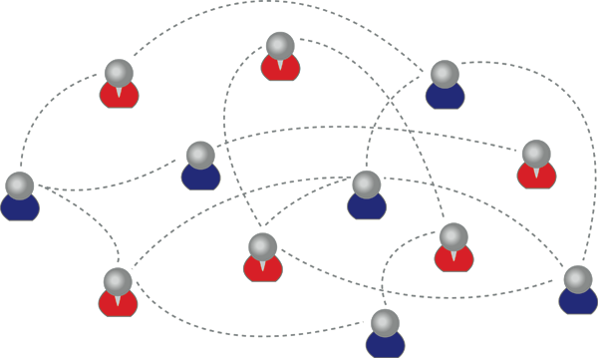
Algorithms and Data Structures
Graphs
Relevant Book Section(s): 8.1, 8.2, 8.3, 8.4

Slide 2
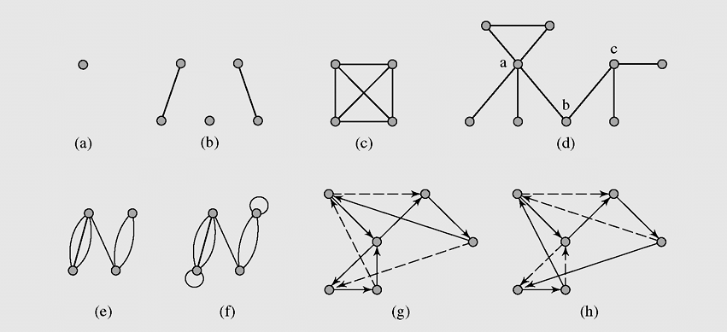
What is a Graph?
A data structure that is used to store elements of data (nodes) and all possible relationships (links) between them.
“edge” or “link”
“node”or vertex
a directed graph

Slide 3
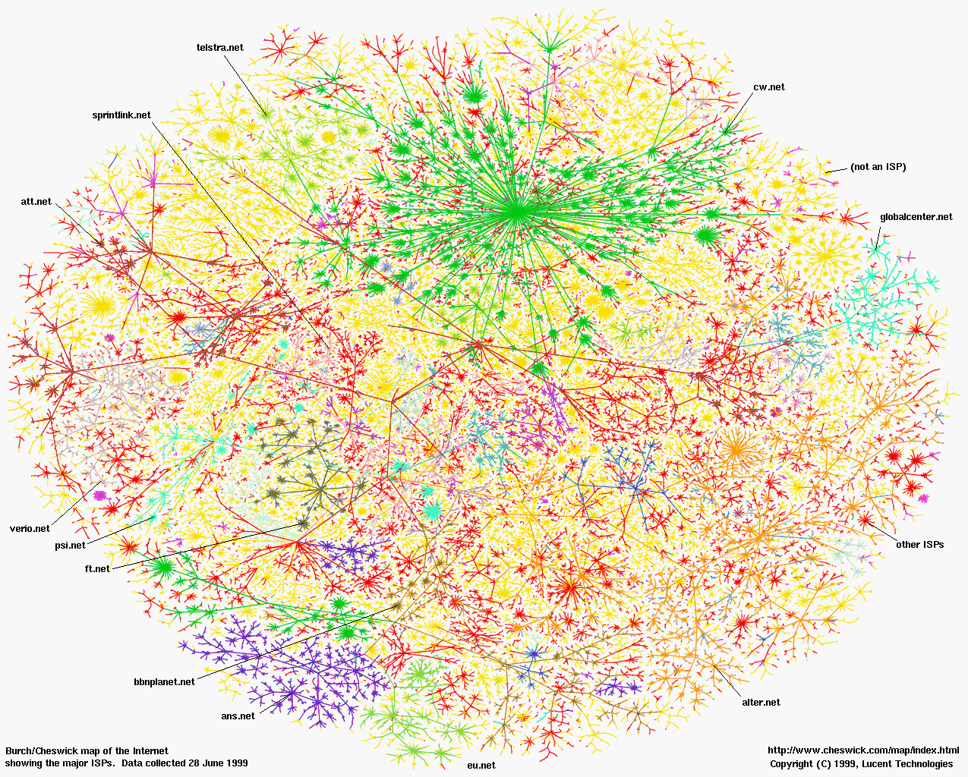
What do we use Graphs for?
Graphs are used to represent all sorts of networks (road networks, computer networks, semantic networks … etc)

Slide 4
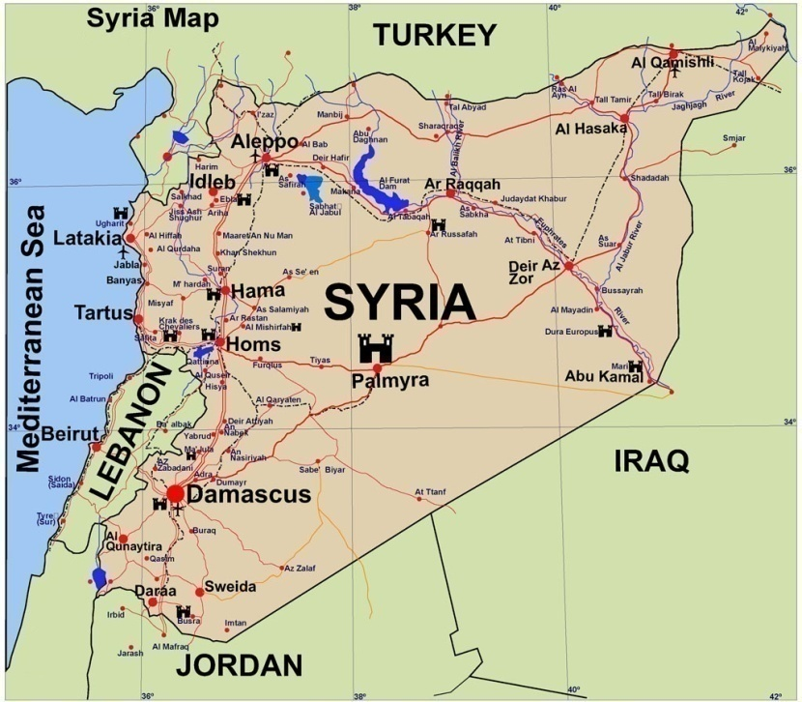

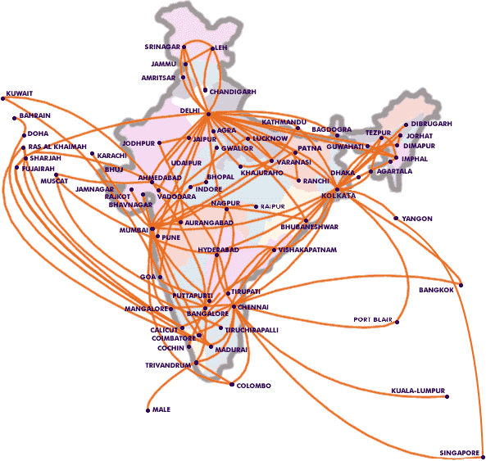
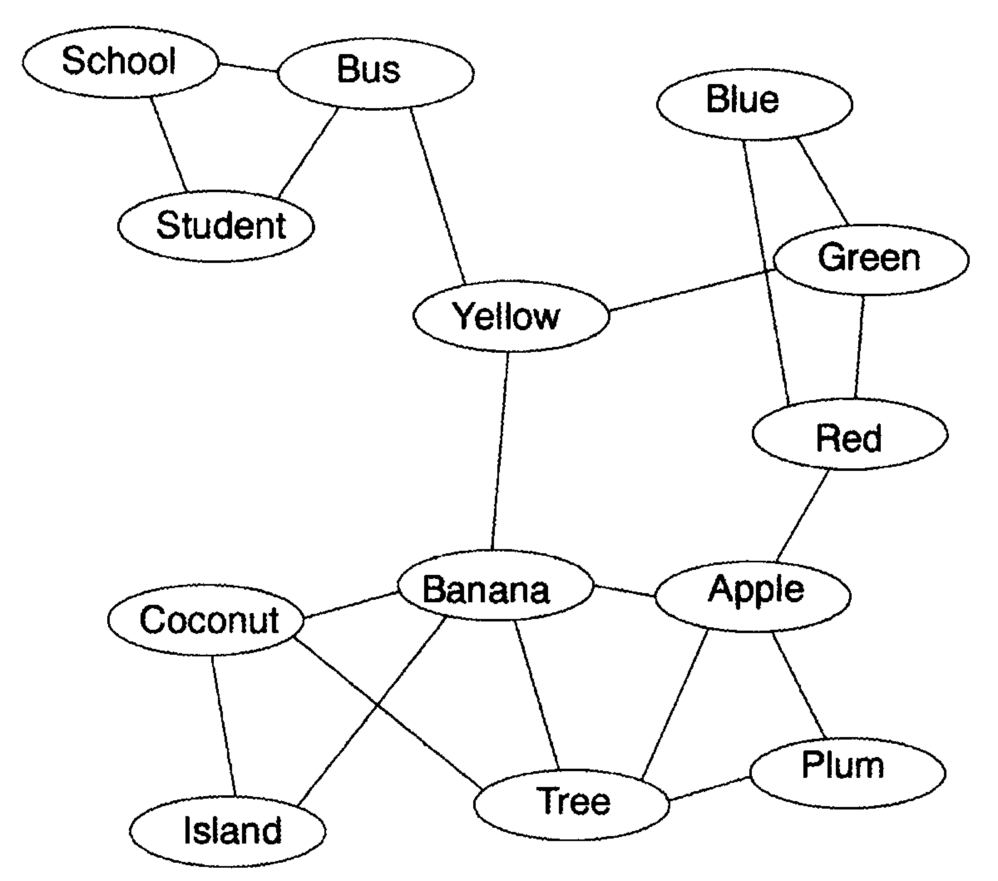
Show me some examples of graphs in real life?
A computer network
A road network
A semantic network
An airline network

Slide 5
What is the difference between a graph and a tree?
The tree is a special case of a graph in which it is only permitted to have edges form a single node in one level to some of the nodes in a lower level. In a graph, there can be an edge be from any node to any other node.
A tree
A graph

Slide 6
How can we represent graphs ?
There are many methods. We will study only two of these:
Adjacency Matrix
Adjacency List

Slide 7

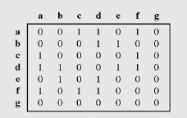
How can we represent a graph using an adjacency matrix ?
a 1 indicates that there is an edge from a to d
The Graph
The Adjacency Matrix

Slide 8
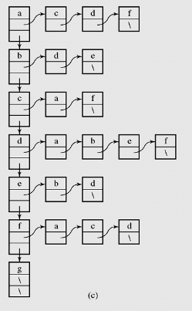
How can we represent a graph using an adjacency List ?
a list of all the nodes of the graph
a list of all the nodes connected to node d
The Graph
The Adjacency List

Slide 9
How can we traverse a graph ?
There are TWO methods:
Depth First Traversal, or Depth First Search (DFS).
Breadth First Traversal, Breadth First Search (BFS).

Slide 10
Show me an example of DFS ?
Al Qamishli
Allepo
Al Hasaka
Idelb
Latakia
Al Raqqah
Deir Azzor
Hama
Tartus
Homs
Palmyra
Damascus
Qunaytira
Sweida
Daraa

Slide 11
What is the algorithm for DFS ?
The DFS algorithm is very simple. It is a greedy algorithm similar to depth first traversal of a BST, except for two main differences:
We should label each node with a flag indicating whether or not this node has already been visited (why did not we need this in a BST ?).
Unlike a binary tree node which has a maximum of two edges (left and right), a graph node has many edges so we must invoke the DFS algorithm for each one of them (using a loop).
The pseudo code for the DFS algorithm can simply be written like this:
void DFS (node* n)
{
visit (n);
for each and every edge (e) connected to n
if (this edge leads to a node (m) that has not been previously visited)
DFS (m);
}

Slide 12
class Graph {
int Size;
(int*)* a ;
bool* Visited;
bool* toBeChecked;
int* CurDist;
int* Pred;
public:
Graph() {Size = 0;}
Graph(int s)
{
Size = s +1;
a = new int* [Size];
for (int i=1; i<=Size; i++)
a[i] = new int [Size];
Visited= new bool [Size];
toBeChecked= new bool [Size];
CurDist= new int[Size];
Pred= new int[Size];
for(int i=1;i<=Size;i++)
for(int j=1;j<=Size;j++)
a[i][j]=0;
for (int i=1;i<=Size;i++)
Visited[i] = false;
}
Graph

Slide 13
void AddEdge (int start,int end,int value = 1)
{
a[start][end] = value;
}
void RemoveEdge (int start,int end)
{
a[start,end] = 0;
}
void print()
{
for (int i=1;i<=Size;i++)
{
for (int j=1;j<=Size;j++)
cout<<a[i][j]<<',';
cout<<endl;
}
cout<<endl;
}
Graph

Slide 14
void DFS(int j)
{
Visited[j] = true;
cout<<j<<" is visited\n";
for (int i=1;i<=Size;i++)
if((a[j][i] != 0) && (Visited[i] == false))
DFS(i);
}
Graph

Slide 15
Example
2
5
1
4
4
3
4
11
3
5
9
8
7
6
7
12
6
2
9
8

Slide 16
void main (){ Graph g(9);
g.AddEdge(1,5,4);
g.AddEdge(2,5,4);
g.AddEdge(2,3,5);
g.AddEdge(3,4,11);
g.AddEdge(3,9,8);
g.AddEdge(4,5,3);
g.AddEdge(4,7,9);
g.AddEdge(5,6,7);
g.AddEdge(6,8,12);
g.AddEdge(7,8,2);
g.AddEdge(7,9,6);
g.AddEdge(4,1,4);
g.AddEdge(5,2,4);
g.AddEdge(3,2,5);
g.AddEdge(4,3,11);
g.AddEdge(9,3,8);
g.AddEdge(5,4,3);
g.AddEdge(7,4,9);
g.AddEdge(6,5,7);
g.AddEdge(8,6,12);
g.AddEdge(8,7,2);
g.AddEdge(9,7,6);
g.print(); g.DFS(1);
Graph

Slide 17
What is the result of the DFS ?
A spanning tree, i.e. a tree that is rooted in the start node and spans all the nodes of the graph.
Al Qamishli
Allepo
Al Hasaka
Idelb
Latakia
Al Raqqah
Deir Azzor
Hama
Tartus
Homs
Palmyra
Damascus
Qunaytira
Sweida
Daraa

Slide 18
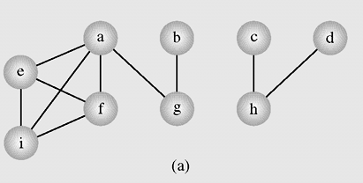
Does the previous DFS code work in all cases ?
NO. If the graph has isolated nodes or sub-graphs, such as the following example, the previous algorithm will fail to visit all the nodes of the graph.

Slide 19
What should we do to the previous DFS code ?
The DFS algorithm should be invoked for every node that has not been visited yet.
void DepthFirstSearch (node* start)
{
DFS (start)
for every node (n) in the graph that has not been visited yet
DFS (n);
}
void DFS (node* n)
{
visit (n);
for each and every edge (e) connected to n
if (this edge leads to a node (m) that has not been previously visited)
DFS (m);
}

Slide 20
How can we perform BFS ?
Exactly like we do BFS for a binary tree but with two differences:
We should label each node with a flag indicating whether or not this node has already been visited (why did not we need this in a BST ?).
Unlike a binary tree node which has a maximum of two edges (left and right), a graph node has many edges so we must invoke the DFS algorithm for each one of them (using a loop).
The pseudo code for BFS algorithm can simply be written like this:
void BFS (node* n)
{
enqueue (n);
while (queue is not empty)
{
dequeue a node from the queue;
visit this node;
for each and every edge (e) connected to this node
if (this edge leads to a node (m) that has not been previously visited)
enqueue (m);
}
}

Slide 21
Does the previous BFS code work in all cases ?
NO. for the same reasons as in this case of DFS.

Slide 22
What should we do to the previous BFS code ?
The BFS algorithm should be invoked for every node that has not been visited yet.
void BFS (node* n)
{
for every node (n) in the graph that has not been visited yet
{
enqueue (n);
while (queue is not empty)
{
dequeue a node from the queue;
visit this node;
for each and every edge (e) connected to this node
if (this edge leads to a node (m) that has not been previously visited)
enqueue (m);
}
}
}

